Slide 1
Software Testing and Debugging Presentation
Brioal Game (Gomoku)
Gary Wu & Zixuan Wang

Slide 2
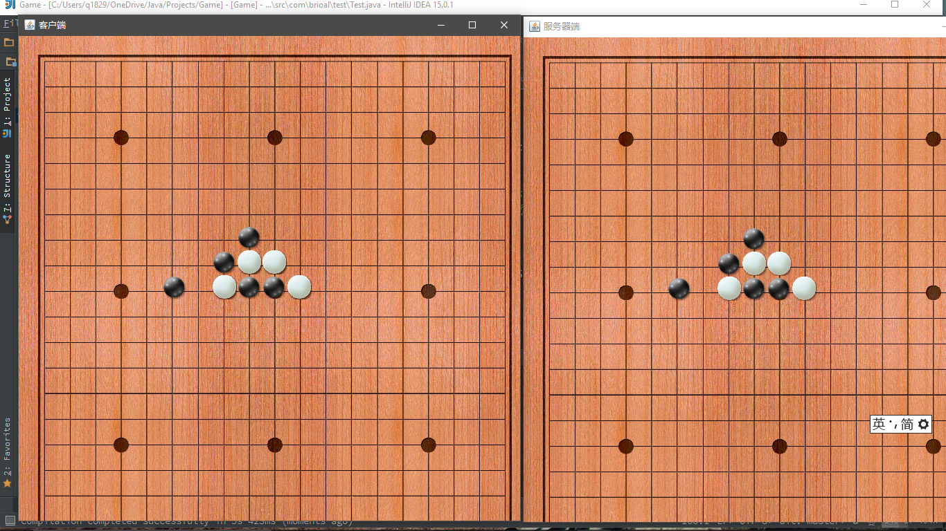
Intro
This is an open-source Gomoku (Five in a row) game written in Java. The basic rule would be shown as follows: the game is played on a 19 x19 board and there are two players that would take black stones and white stones. The black stone side always goes first and two players alternate turns placing a stone of their color on an empty intersection. The winner is the one who first has 5 stones of his/her color connected horizontally, vertically or diagonally.

Slide 3
Tools Used
Juint 5 For unit & integration testing
Jacoco to generate test report
AssertJ Swing for GUI testing
PIT for mutation testing
*Mockito for mock testing (future implementation)

Slide 4
Project Structure
● 5 classes to render the welcome page for the game ● 5 classes to handle the user events (such as mouse clicking and update the panel) ● 3 classes to set up different panels ● 2 classes for utils that would set up the main rule (detect winning) and encapsulate the properties of a fundamental stone

Slide 5
Live Demo

Slide 6
GUI testing
File Structure
Button
Panel
Frame
Example: Select Button
Metric: Select Button should be in “selected” state after being clicked

Slide 7
Whitebox & Blackbox Testing
Black Box Testing:
EP(White Point, Black Point and Neither)
BA (i < 0, 0 <= i <= 19, i > 19)
EG (Did the developer check both directions? All possibilities?)
White Box Testing: We aimed for 100% branch coverage, but there are several lines in the code that we deemed unreachable.

Slide 8
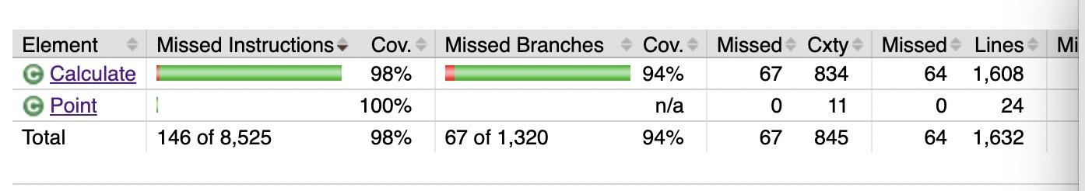
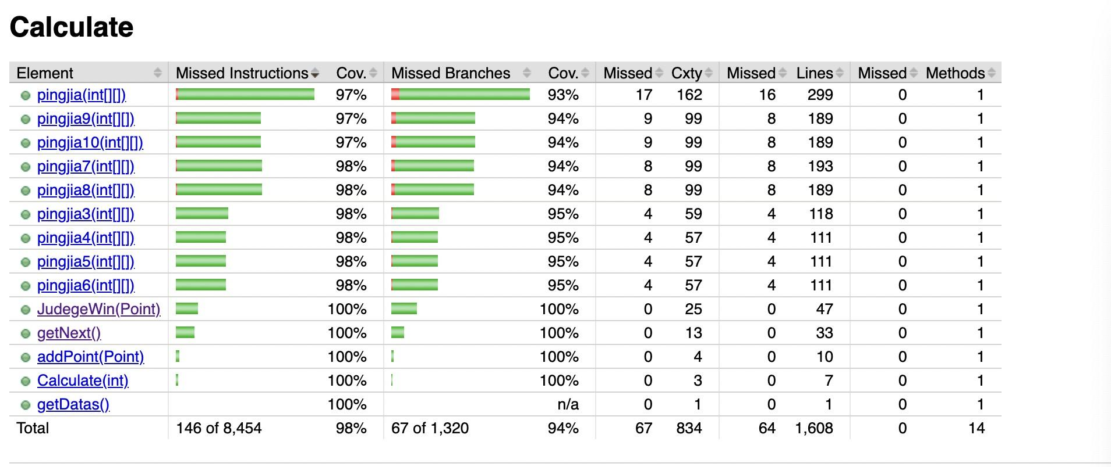
Branch Coverage

Slide 9
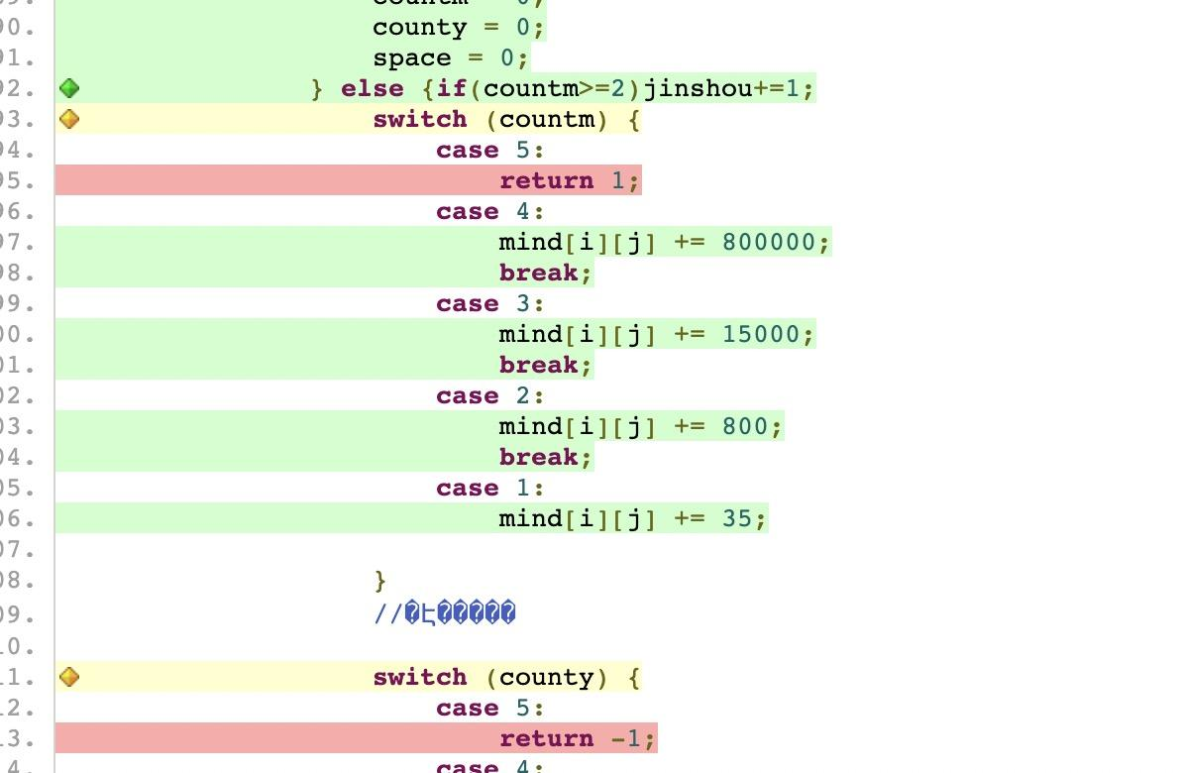

Slide 10
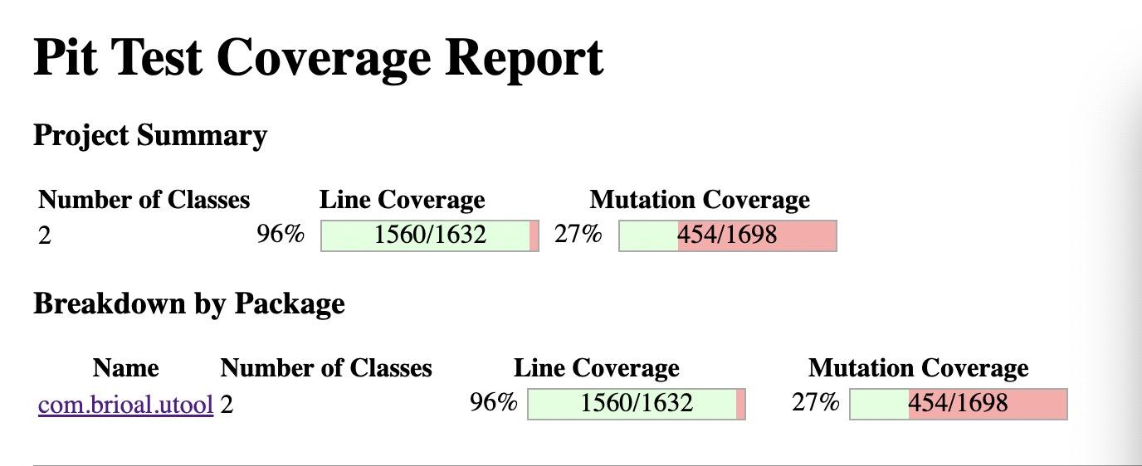
Mutation Testing

Slide 11
Faults Found
Through Blackbox and Whitebox Testing:
For Point Class:
Set point.x, point.y and point.state to invalid values should raise an exception (no boundary checking)
For Calculate Class:
Add Point:
Adding white point using black instance should return false
Adding points with state that’s not 1/-1 should raise exception. But instead it always returns -1 (always return white)
JudgeWin:
5 stones with invalid state should not return True
JudgeWin function does not work as expected because other methods changed the board state
GetNext: Used prob the range method to check whether the generated point is in the board

Slide 12
Faults Found
PJ:
For Several of them, one diagnal is missing, and only one direction is checked
It divides the grid to several subgrids, which leads to a problem that if stones are placed in a row but in different subgrids, the algorithm would not be able to detect
The algorithm changed the internal state of the board which results in some unreachable statements
The algorithm does not restore the state after changing the value
Never checks row 0 and col 0
Does not check a scneario where we have 3 + blank + 1

Slide 13
Lesson Learned
Documentations are important
Check input values

Slide 14
Conclusion & Proposed Fixes
Mock Testing For Client/Server class
Change the algorithm for pingjia and judgeWin

Slide 15
Questions?

Slide 16
Thank You!

